Slide 1


Visvesvaraya Technological University, beLAGAVI-590014
DAYANANDA SAGAR ACADEMY OF TECHNOLOGY AND MANAGEMENT
Udayapura, Kanakapura Road, Bangalore-560082
Department of Electronics and Communication Engineering
MINI PROJECT PRESENTATION
PROJECT TITLE:
“IMPLEMENTATION OF IOT BASED
ACCIDENT DETECTION AND PREVENTION SYSTEM”
Submitted by
MEDHA R(1DT19EC045)
NADEEM ABDUL RAZAK GULAM(1DT19EC048)
NEHA PANDEY(1DT19EC051)
RAKSHITH V K(1DT19EC060)
Under the Guidance of
Mrs. KALPAVI C Y
(Asst. Professor, Dept. of ECE)

Slide 2
SL NO. | CONTENTS
1 | INTRODUCTION
2 | LITERATURE REVIEW
3 | PROBLEM DEFINITION
4 | OBJECTIVES
5 | PROJECT REQUIREMENTS
6 | DEATAILED BLOCK DIAGRAM
7 | APPLICATIONS
8 | ADVANTAGES
9 | FLOW DIAGRAM
10 | CODE
11 | REFERENCES

Slide 3
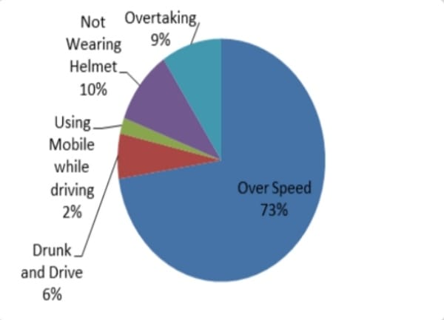
introduction
According to a survey, there are around 1214 accidents that occur due to bike crashes every day in India alone and two-wheelers account for 25% of the deaths due to road accidents.
There are 3 major factors which are essential to avoid and detect accidents
Wearing the helmet at all times while riding.
Detection of alcohol content.
Informing the family members and contacting the ambulance services.

Slide 4
Literature review
SL. No | TITLE and AUTHOR | JOURNAL & YEAR | TAKE AWAY POINTS
[1] | "A Comprehensive Study on IoT Based Accident Detection Systems for Smart Vehicles“ U. Alvi, M. A. K. Khattak, B. Shabir, A. W. Malik and S. R. Muhammad | IEEE 2020 | Comparative study on various accident detection and prevention systems.
[2] | “Smart Accident Prevention Technique by using Brain Wave Signal” Dr. T. Kalaichelvi, Dr. V. Subedha ,Mrs. APorselvi , S. Krishna, S. Divakar | IJERT 2020 | Automated system for the detection of brain abnormalities.
[3] | “Accident prevention and safety assistance using IOT and machine learning” S.Uma, Eswari Rajagopal | JRIE 2022 | Cloud services and machine learning models are employed to identify fatigue drivers.
[4] | “IoT-Based Accident Prevention System Using Machine Intelligence” S Surya, Abdul Quadir, Arun Kumar Sivaraman | IJERT 2021 | Machine learning algorithms to predict accidents before they happen.
[5] | “Smart Helmet for Bike Riders Safety” S. Shafiulla Basha, B. P. Santosh Kumar , Syed. Jahangir Badashah | IJRASET 2022 | Smart Alcohol and Helmet detection.

Slide 5
Problem definition
Accidents can happen at any time without any warning.
People are negligent toward safety measures.
No timely response available to accident victims.

Slide 6
objectives
To reduce the human death ratio.
To ensure that the rider is wearing the helmet.
To detect whether the driver has consumed alcohol or not.
To detect the accident and send a message immediately to the family/ambulance services.

Slide 7
PROJECT REQUIREMENTS
HARDWARE REQUIREMENTS: | SOFTWARE REQUIREMENTS:
Arduino UNO R3 | Arduino IDE
Accelerometer MPU 6050
IR-Sensor
Alcohol sensor(MQ3)
GSM Module SIM 900A
GPS Module Neo-6
LED / Buzzer

Slide 8
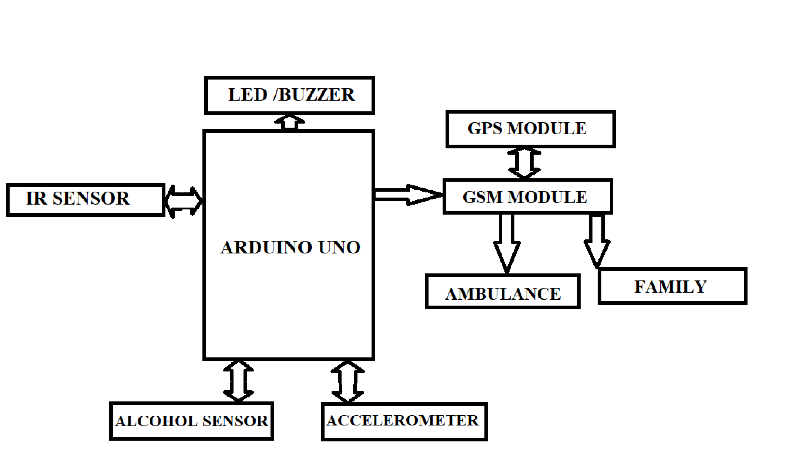
DETAILED BLOCK DIAGRAM
Fig 1: Block diagram of Proposed Method.

Slide 9
applications
To alert the nearby health services.
Application can make use of the sensor in mobile, that will sense the accident of vehicle.
Share the exact location of accident.
To prevent the rider from drinking and driving.

Slide 10
ADVANTAGES
Accidents can be prevented before hand.
GSM and GPS module has been used.
More Reliable.
Emergency contact can be changed easily.

Slide 11
DEVICE ON
LED ON
Is the person wearing the helmet?
YES
LED OFF
NO
LED ON/BUZZER ON
Is the alcohol amount<threshold
YES
Engine Turns ON
NO
Engine remains in OFF state
FLOW DIAGRAM FOR PREVENTION SYSTEM

Slide 12
FLOW DIAGRAM FOR DETECTION SYSTEM
DEVICE ON
ACCIDENT HAS TAKEN PLACE?
YES
MESSAGE IS SSENT TO FAMILY/AMBULANCE
NO
GPS LOCATION IS MONITORED

Slide 13
CODE FOR PREVENTION SYSTEM
//IR Sensor config
int IRSensor = 2; // connect ir sensor to arduino pin 2
int LED = 13; // conect Led to arduino pin 13
int buzzer=10;
//Alcohol Sensor config
#define Sober 50 // Define max value that we consider sober
#define Drunk 100 // Define min value that we consider drunk
#define MQ3pin 0
float sensorValue; //variable to store sensor value
void setup() {
//IR Sensor pin config
pinMode (IRSensor, INPUT); // sensor pin INPUT
pinMode (LED, OUTPUT); // Led pin OUTPUT
pinMode (buzzer, OUTPUT); //buzzer config
//Alcohol Sensor Pin config
Serial.begin(9600); // sets the serial port to 9600
Serial.println("MQ3 warming up!");
delay(2000); // allow the MQ3 to warm up
// digitalWrite(Relay,HIGH);
}

Slide 14
void loop() {
// digitalWrite(Relay,HIGH);
///IR sensor logic
int statusSensor = digitalRead (IRSensor);
if (statusSensor == 1){
digitalWrite(LED, HIGH); // LED LOW
}
else
{
digitalWrite(LED,LOW);
}
if( statusSensor == LOW){sensorValue = analogRead(MQ3pin); // read analog input pin 0
Serial.print("Sensor Value: ");
Serial.print(sensorValue);
// Determine the status
if (sensorValue < Sober) {
Serial.println(" | Status: Stone Cold Sober");
digitalWrite(buzzer, LOW);
} else if (sensorValue >= Sober && sensorValue < Drunk) {
Serial.println(" | Status: Drinking but within legal limits");
digitalWrite(buzzer, LOW);
} else {
Serial.println(" | Status: DRUNK");
digitalWrite(buzzer, HIGH);
}
delay(2000); // wait 2s for next reading
}
}

Slide 15
CODE FOR DETECTION
#include <TinyGPS++.h>
#include <SoftwareSerial.h>
#include "I2Cdev.h"
#include "MPU6050.h"
#if I2CDEV_IMPLEMENTATION == I2CDEV_ARDUINO_WIRE
#include "Wire.h"
#endif
MPU6050 accelgyro;
//MPU6050 accelgyro default address is 0x68; // <-- default AD0 is low
//MPU6050 accelgyro(0x69); // <-- use for AD0 high
int16_t ax, ay, az;
int16_t gx, gy, gz;
#define OUTPUT_READABLE_ACCELGYRO
static const int RXPin = 4, TXPin = 3;
static const uint32_t GPSBaud = 9600;
TinyGPSPlus gps;
void setup() {
pinMode(13,OUTPUT); //For getting a sound from buzzer
pinMode(12,INPUT_PULLUP);
Serial.begin(19200);
ss.begin(GPSBaud);
SIM900.begin(19200);
Serial.print("SIM900 ready...");
// AT command to set SIM900 to SMS mode
SIM900.print("AT+CMGF=1\r");
delay(100);
// Set module to send SMS data to serial out upon receipt
SIM900.print("AT+CNMI=2,2,0,0,0\r");
delay(100);
#if I2CDEV_IMPLEMENTATION == I2CDEV_ARDUINO_WIRE

Slide 16
Wire.begin();
#elif I2CDEV_IMPLEMENTATION == I2CDEV_BUILTIN_FASTWIRE
Fastwire::setup(400, true);
#endif
// initialize serial communication
Serial.begin(19200); //do not forget to change the baud rate to 19200 in your output screen
// initialize device
Serial.println("Initializing I2C devices...");
accelgyro.initialize();
// verify connection
Serial.println("Testing device connections...");
Serial.println(accelgyro.testConnection() ? "MPU6050 connection successful" : "MPU6050 connection failed");
}
void loop() {
accelgyro.getMotion6(&ax, &ay, &az, &gx, &gy, &gz);
Serial.println(ax);
delay(10);
if(ax>5000 || ax< -5000){
sendsms();
}
}
void sendsms(){
if (ss.available() > 0){
gps.encode(ss.read());
if (gps.location.isUpdated()){
Serial.print("GPS FIXED");
Serial.print("Latitude= ");
Serial.print(gps.location.lat(), 6);
Serial.print(" Longitude= ");
Serial.println(gps.location.lng(), 6);
}
}

Slide 17
SIM900.println("AT + CMGS = \"+919964466732\"");
delay(100);
Serial.println("Sending SMS");
SIM900.println("A CRASH of vechicle has been detected, please try to contact the driver");
delay(100);
// Send the SMS text message
SIM900.print("https://www.google.com/maps/?q=");
SIM900.print(gps.location.lat(), 6);
SIM900.print(gps.location.lng(), 6);
delay(100);
// End AT command with a ^Z, ASCII code 26
SIM900.println((char)26);
delay(100);
SIM900.println();
// Give module time to send SMS
delay(5000);
}

Slide 18
REFERENCES
[1] U. Alvi, M. A. K. Khattak, B. Shabir, A. W. Malik and S. R. Muhammad, "A Comprehensive Study on IoT Based Accident Detection Systems for Smart Vehicles," in IEEE Access, vol. 8, pp.
122480-122497, 2020, doi:10.1109/ACCESS.2020.3006887.
[2]Dr. T. Kalaichelvi, Dr. V. Subedha, Mrs. APorselvi, S. Krishna, S. Divakar “Smart Accident
Prevention Technique by using Brain Wave Signal”, IJERT,2022.
[3]S.Uma, Eswari Rajagopal, “Accident prevention and safety assistance using IOT and machine learning”, JRIE,2022
[4]S Surya, Abdul Quadir, Arun Kumar Sivaraman, “IoT-Based Accident Prevention System Using Machine Intelligence”, IJERT ,2021
[5]S. Shafiulla Basha, B. P. Santosh Kumar, Syed. Jahangir Badashah ,“Smart Helmet for Bike Riders Safety”, IJRASET,2022

Slide 19
THANK YOU

